Slide 1


Chloe Drummond
2/19/2025

Slide 2

Outline
Executive Summary
Introduction
Methodology
Results
Conclusion
Appendix

Slide 3
Executive Summary
Methodology
Results
Collected data from SpaceX Rest API as well as web scraping tables from Wiki pages.
Wrangled data for future analysis
Performed EDA using SQL, Pandas, & Matplotlib
Created interactive Visuals using Folium and Plotly Dash
Built ML pipeline to predict if first stage of Falcon 9 lands successfully
Was able to see early analysis information like success rate
EDA gave insightful relationships like the launch success trend over the years
Interactive visualizations allowed better pattern visualization and allowed optimal launch site selection
Predictive models all performed relatively well with ~83% accuracy. Small test sample is likely main cause of the lack of differentiation.

Slide 4
Introduction
Background & Context
Purpose
The new age of space is here. SpaceX is one of the more successful companies aiming to make space travel more affordable. It does this by being able to resuse its first stage of launch. If we can determine if the first stage will successfully land then we can calculate the cost of a launch.
The purpose of this project is to determine the price of each launch for a competing company SpaceY. This includes determining if SpaceX will reuse the first stage and predicting if the first stage will land successfully.

Slide 5

Section 1

Slide 6
Methodology
Executive Summary
Data collection methodology:
Data collected from API GET requests and Web-scraping from Wiki page.
Perform data wrangling
Used two gathered tables to create class column of successful/failed landings.
Perform exploratory data analysis (EDA) using visualization and SQL
Perform interactive visual analytics using Folium and Plotly Dash
Perform predictive analysis using classification models
Split into 80/20 split
Performed GridSearchCV for logistic regression, SVC, Decision Tree, KNN
Created confusion matrix and found accuracy to determine best model.

Slide 7
Data Collection – SpaceX API
Requst and parse json file into dataframe using json_normalize
Dealt with missing values in PayloadMass column with the mean.
Exported dataframe to csv file.
Took smaller subset and focused on the data of interest. Then used API again to get rocket, payload, launchpad and other core data.
Took that gathered data dictionary and converted it to dataframe. Filtered the dataframe to only include Falcon 9
API Github Link

Slide 8
Data Collection - Scraping
Used requests.get() to request Launch HTML page as an HTTP response. Then made BeautifulSoup object from response text content
Create dictionary with keys from the extracted column names and parse values from the HTML tables. Then convert dictionary into pandas dataframe
Exported dataframe into csv file
Using HTML table header elements, find and extracted column names
Scraping GitHub Link

Slide 9
Data Wrangling
First we loaded in the API collected dataset, then did some initial viewing like the percentage of missing values and column types
Then we find the number of launches on each Launch Site, the number and occurrence of each orbit, and the number and occurrence of the different mission outcomes
Exported dataframe to csv file
Then we made a list of the bad outcomes. Using that we created a new variable landing_class and assigned 0 if the outcome is bad and 1 if not.
Data Wrangling GitHub Link

Slide 10
EDA with Data Visualization
Github Link
Scatterplot of Payload Mass and Flight Number colored by Class
Shows the spread of the payload mass by success.
Scatterplot of Launch Site and Flight Number colored by Class
See spread of different flights at each site and their outcome
Scatterplot of Payload and Launch site colored by Class
Observe relationship between sites and mass.
Bar Chart for success rate of each orbit
See relationship of success rate for each orbit.
Scatterplot of Flight number vs Orbit and Payload vs Orbit
See relationship between two variables
Line Chart of Year vs Success Rate
View yearly trend of success

Slide 11
EDA with SQL
Display unique launch site names from SpaceXtable
Display first 5 records with launch sites that start with CCA
Display total payload mass carried for the customer NASA
Display average payload mass for booster version F9 v1.1
List the date when first successful landing in ground pad happened
List the booster names which have success in drone ship and have payload mass between 4000 and 6000 kg
List the total number of successful and failure mission outcomes
Use subquery to list names of booster versions that have carried the max payload mass.
List the records which display months, failure landings in drone ship, booster versions and launch site for months in 2015
List each landing outcome type and occurrence between 2010-06-04 and 2017-03-20 in descending order of number of occurrences
Github Link

Slide 12
Build an Interactive Map with Folium
Center location is Johnson Space Center in Houston, Texas
Added circle object for each launch site with name as a popup label
Launch sites are mainly by the coasts and are somewhat close to equator line
MarkerCluster object created to add markers for all launch records in colors related to their class.
Marker cluster used since many launch records will have same coordinates
Mouse position to get any coordinate on a map, create marker to show distance between launch site and mouse coordinate.
Used to show distance between launch site and nearest coastline
PolyLine added between launch site and selected coastline point
Github Link

Slide 13
Build a Dashboard with Plotly Dash
Dropdown menu to chose between site specific information or total for all sites
Pie chart for all sites shows success rate for each site. Site specific pie chart shows percentage of success and failures for that site
Scatterplot of Payload vs Success for all sites or one specific site based on dropdown selection. Colors show different booster versions
Payload range slider to filter different ranges of mass on the scatterplot.
GitHub Link

Slide 14
Predictive Analysis (Classification)
Perform Logistic regression & GridSearchCV to find best parameters.
Create SVM & GridSearchCV to find best parameters
Using best parameters find validation data accuracy and test data accuracy
Transform & Standardize data to prep for processing
Split data into test & training data using 20/80 split
Plot Confusion matrix
Create Decision tree classifier & GridSearchCV to find best parameters
Create KNN & GridSearchCV to find best parameters
GitHub Link

Slide 15
Results
EDA shows that time and repetition is beneficial to the success chances of landing the first stage since there is a positive correlation between success rate and flight number and the yearly trend shows a positive increase in success rate over increasing years.
Payload mass does seem important as well as the smaller payloads seem to be more successful
Interactive plots show that site KSC LC-39A was most successful. This site was less than 8 KM away from any coast, highway, and railway. This could lead to lower costs in materials transportation so that funds can be better allocated since the site is so close to transportation sites.
Decision Tree gave the best validation accuracy of 0.875 while all of the models gave the same testing accuracy of 0.8333 since we had a small testing data size.

Slide 16

Section 2

Slide 17
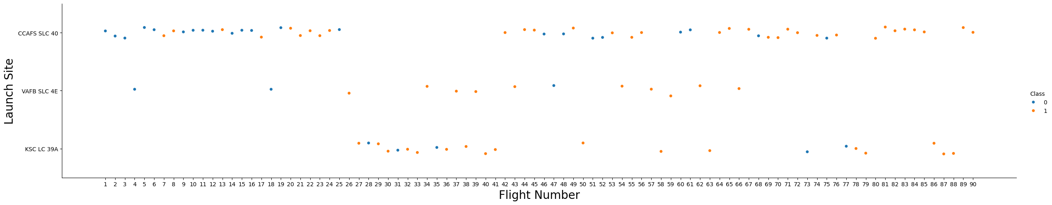
Flight Number vs. Launch Site
Least amount of flights at VAFB SLC 4E while most at CCAFS SLC 40. Later flights more successful

Slide 18
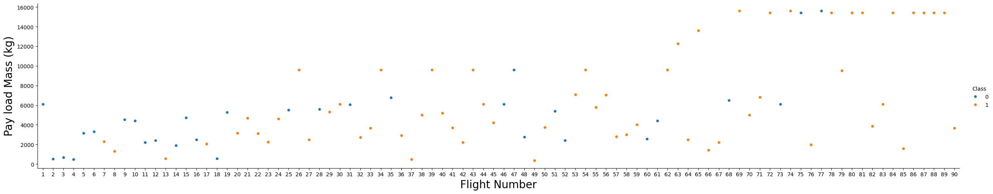
Flight Number vs. Payload Mass
It seems that the more massive the payload the less likely the first stage is to return.

Slide 19
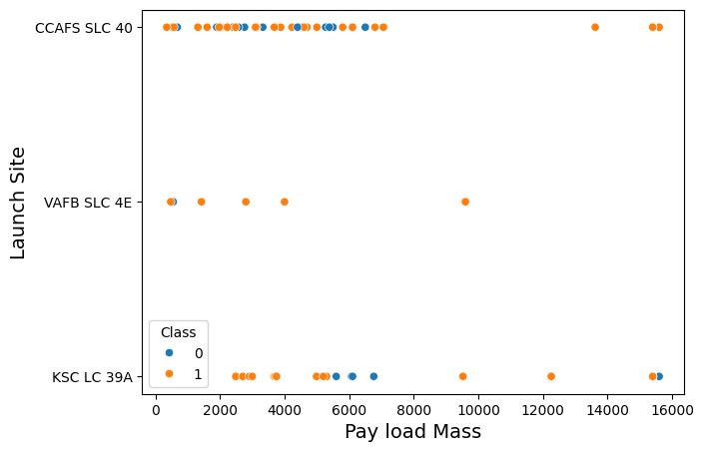
Payload vs. Launch Site
Site VAFB SLC 4E had no launches for mass greater then 10000. Site CCAFS SLC 40 had 3 success with mass greater than 12000

Slide 20
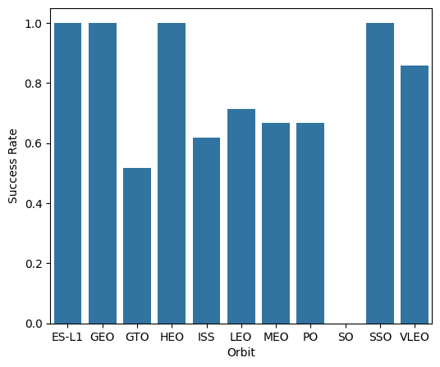
Success Rate vs. Orbit Type
Orbits ES-L1,EO, HEO, SSO had highest success rate

Slide 21
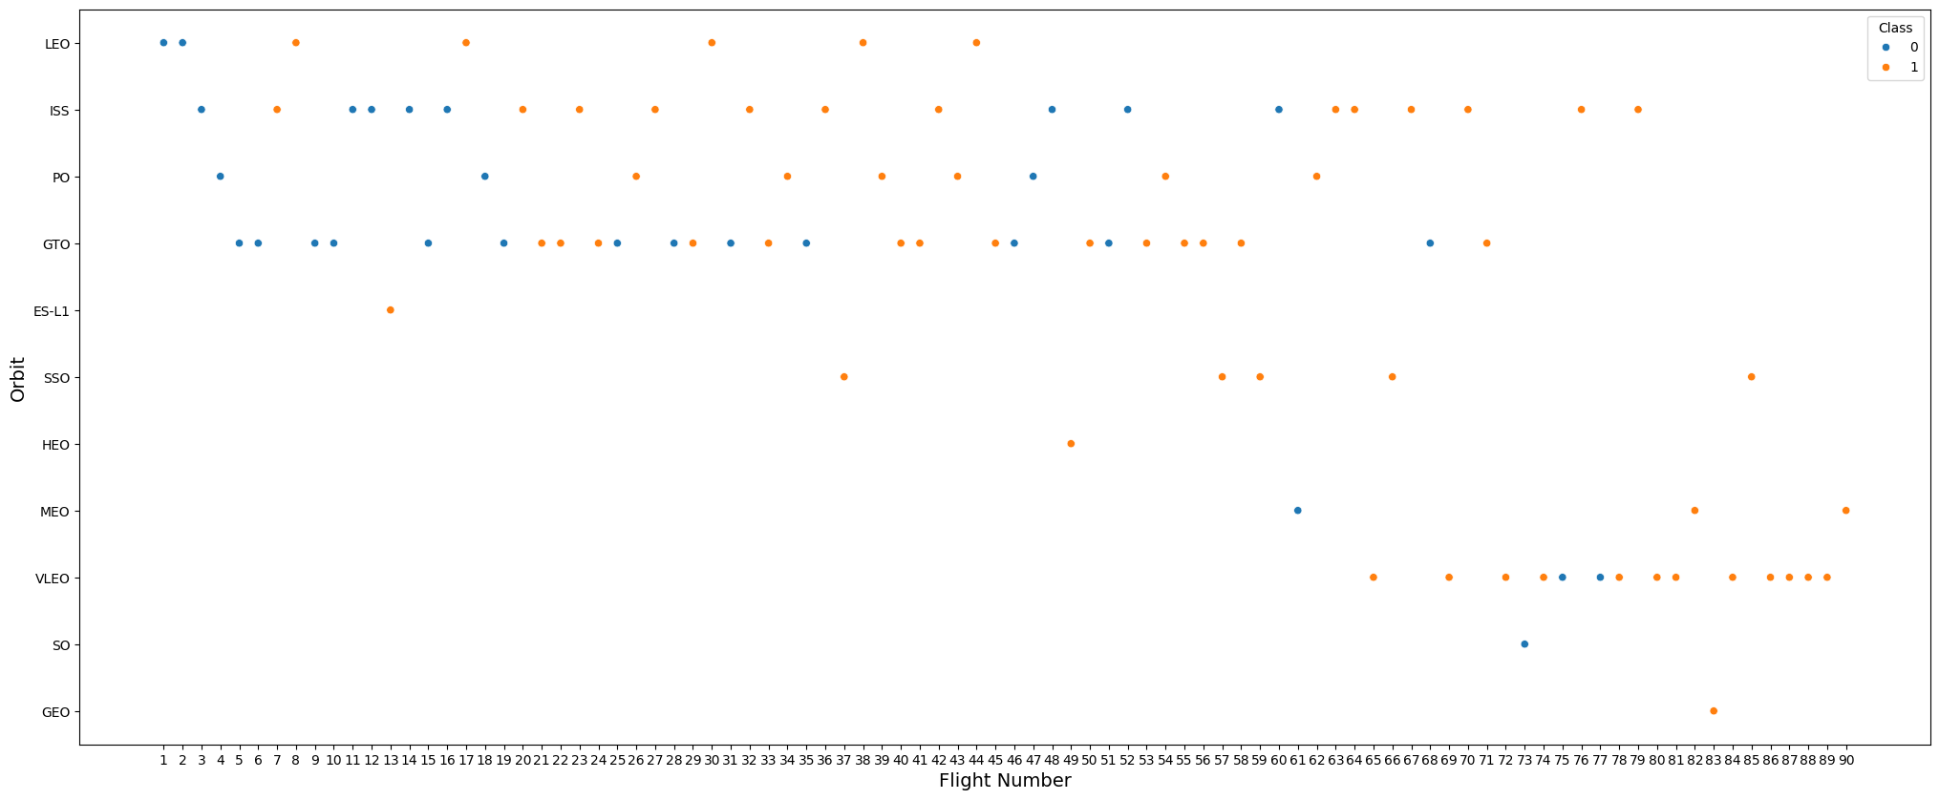
Flight Number vs. Orbit Type
Leo orbit Success is related to the flight number, while no relationship in other orbits.

Slide 22
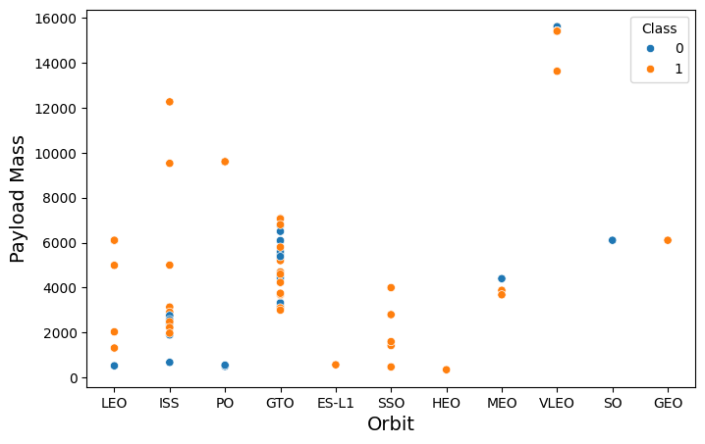
Payload vs. Orbit Type
Heavy mass have positive success rate more for Polar, LEO, ISS

Slide 23
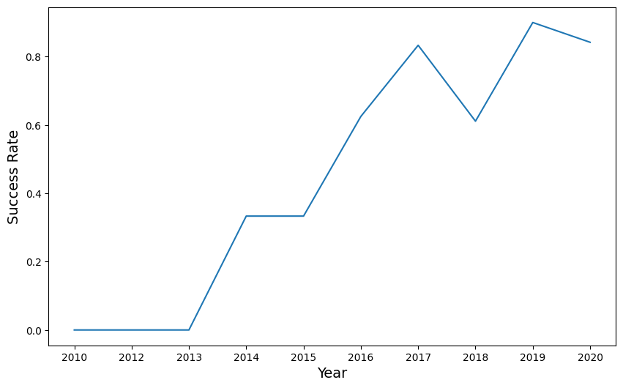
Launch Success Yearly Trend
Success increases since 2013 with some leveling out in 2014 and a small drop in 2017.

Slide 24
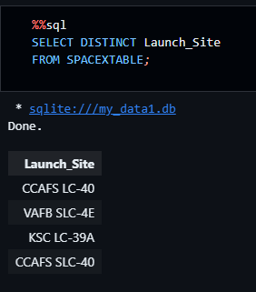
All Launch Site Names
Extracted the unique launch site names from the table

Slide 25
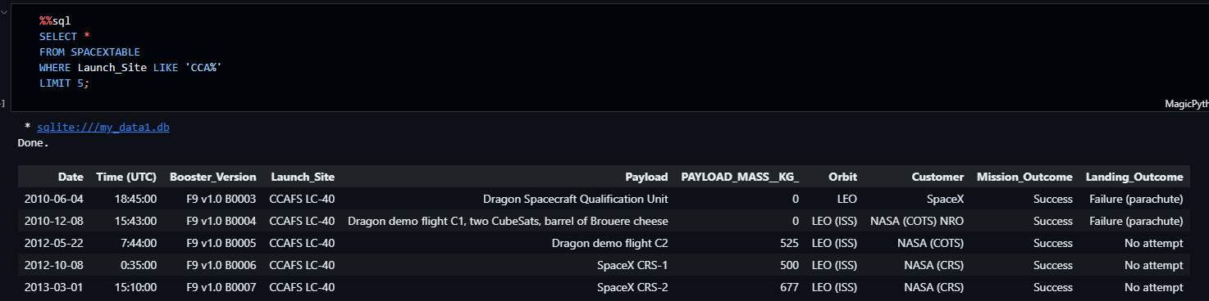
Launch Site Names Begin with 'CCA'
Used like to find the launch sites from the table that begin with CCA but have anything afterwards with the %. The limit 5 shows only the first 5 entries.

Slide 26
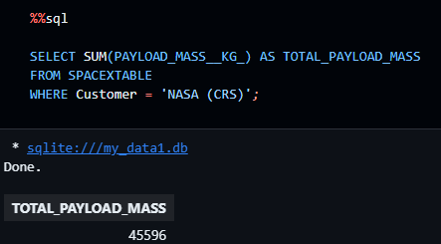
Total Payload Mass
Finds the sum of the payload mass from the flights where the customer is Nasa. Assigns it to Total_payload_mass.

Slide 27
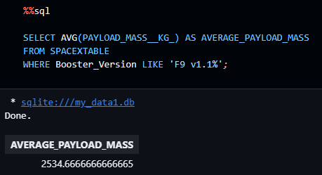
Average Payload Mass by F9 v1.1
Found average of the payload mass where the booster version was F9 v1.1.

Slide 28
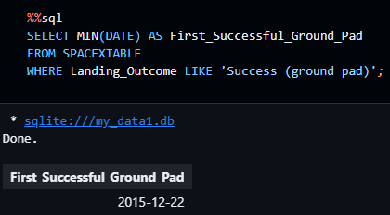
First Successful Ground Landing Date
Using the min function on date it finds the first date where the landing outcome is success (ground pad)

Slide 29
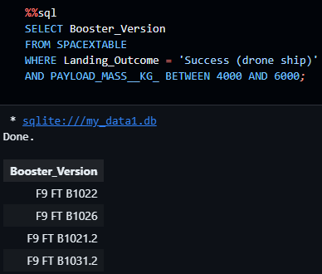
Successful Drone Ship Landing with Payload between 4000 and 6000
These Booster versions had a successful drone ship landing with payload masses between 4000 and 6000 kg.

Slide 30
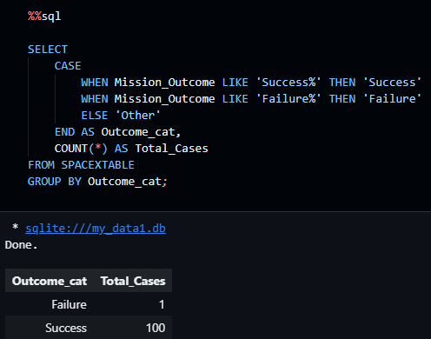
Total Number of Successful and Failure Mission Outcomes
Only 1 failure and 100 successes

Slide 31
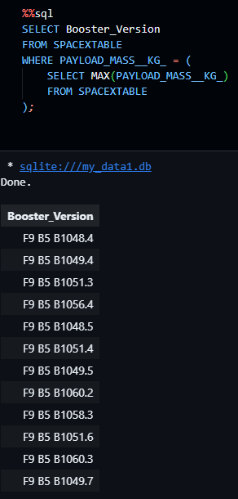
Boosters Carried Maximum Payload
Suquery of select max() to find booster versions that carry the max payload mass

Slide 32
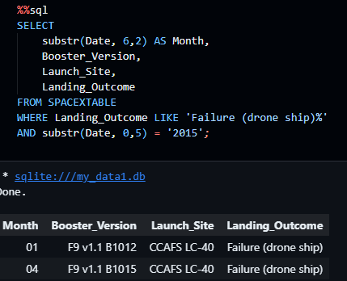
2015 Launch Records
Months January and April have the two records where there was a failure drone ship landing.

Slide 33
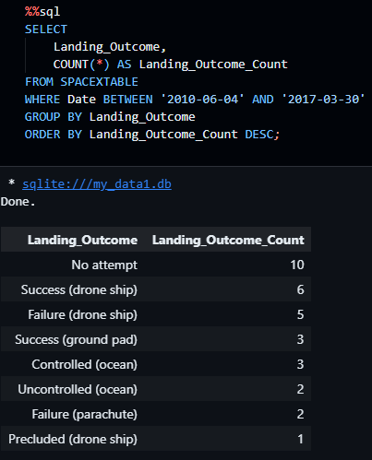
Rank Landing Outcomes Between 2010-06-04 and 2017-03-20
No attempt at landing had the most occurrences while Precluded (drone ship) only had 1

Slide 34

Section 3

Slide 35
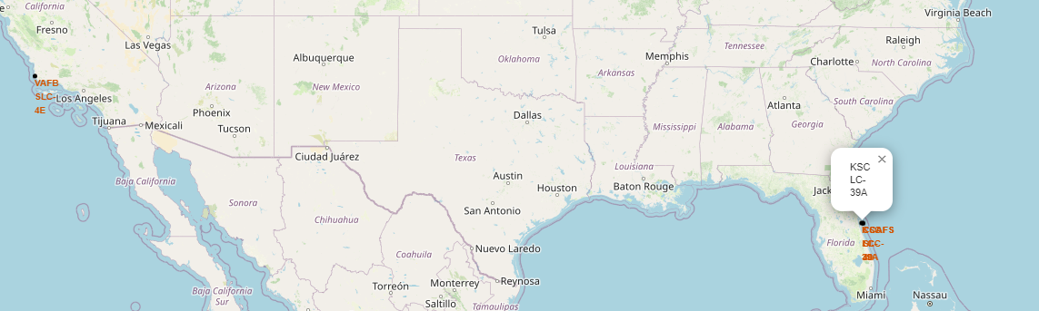
Launch Site Markers
Launch sites are along the coast close to the equator while staying in the USA

Slide 36
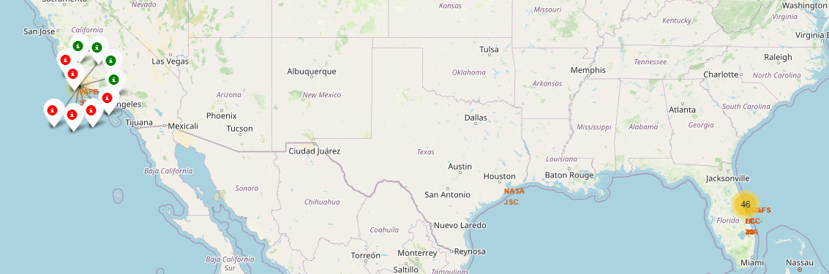
Successful and Failed Landings at Launch Sites
Green is successful landing and red is a failed landing

Slide 37
Distance to Nearest Highways, Railroads, Coasts
Chose site KSC LC-39A since it has the best success rate. It was no more than 8 KM away from any major point.

Slide 38

Section 4

Slide 39
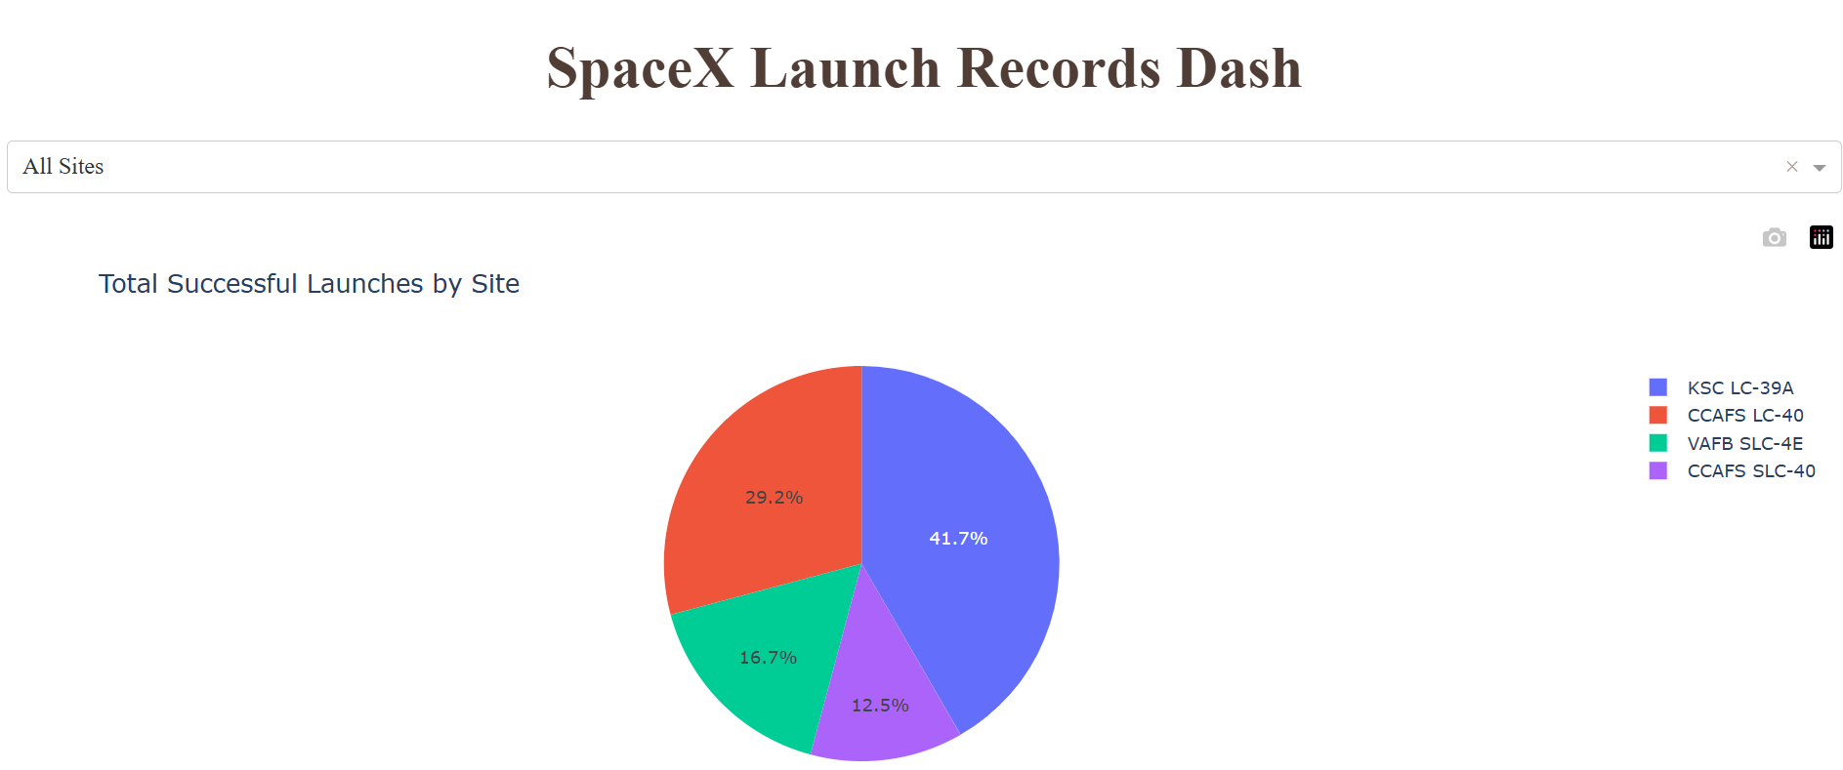
Successful Launches by Site
The launch site that was most successful is the KSC LC-39A site while the least successful site is the CCAFS SLC-40 site.

Slide 40
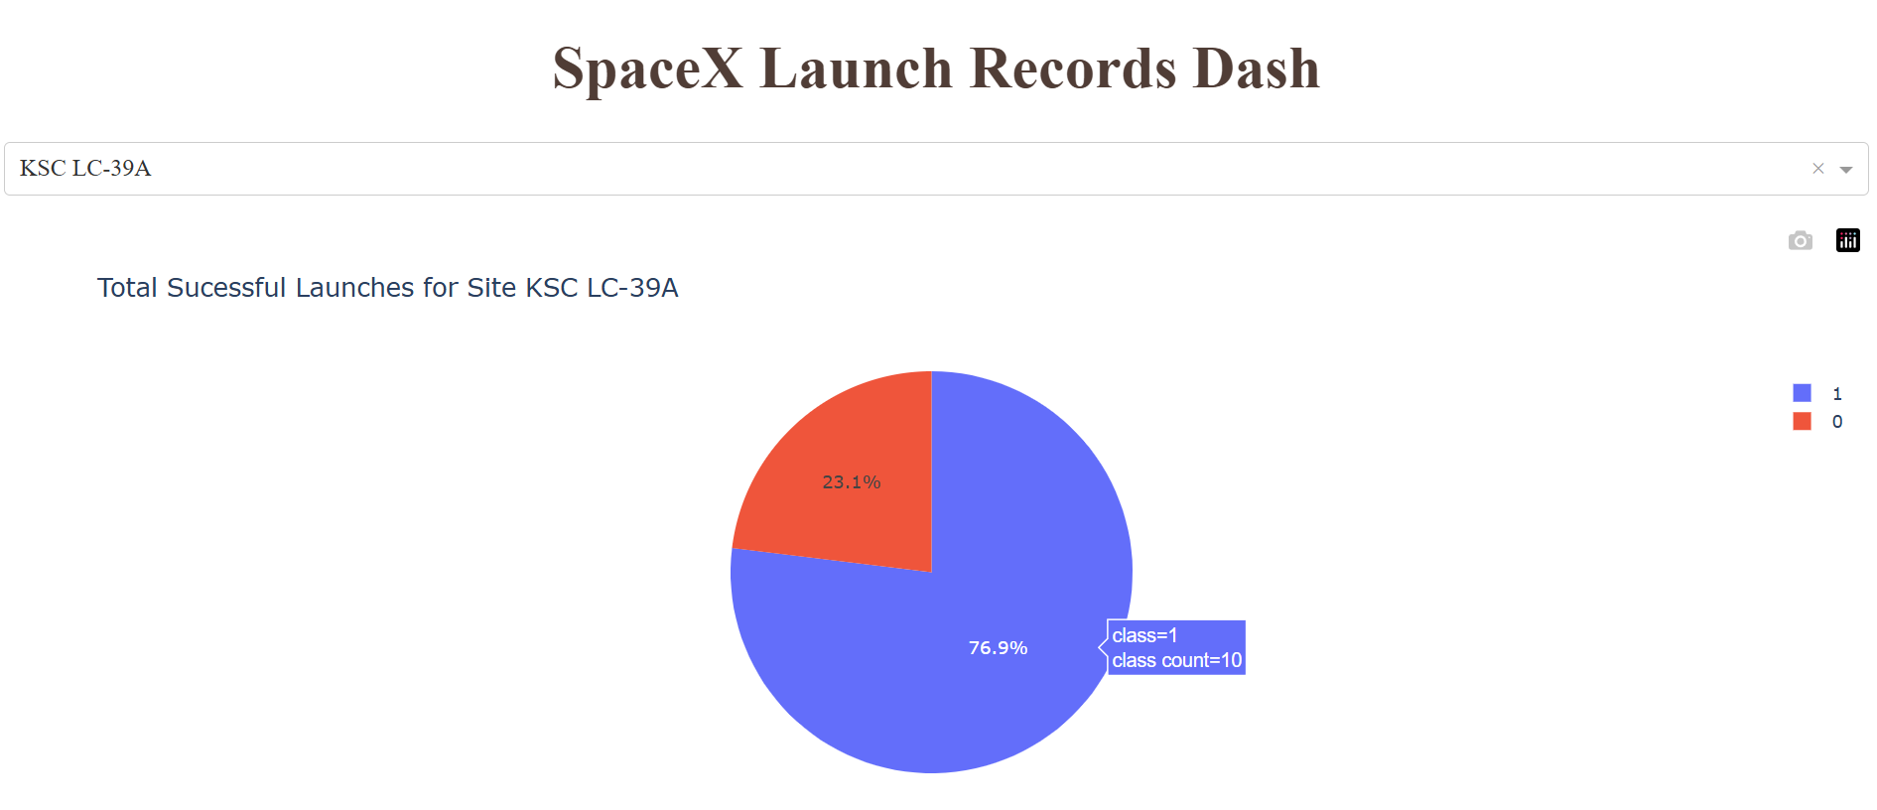
KSC LC-39A Breakdown
Out of 13 total launches site KSC LC-39A had 10 successful launches and 3 failures

Slide 41
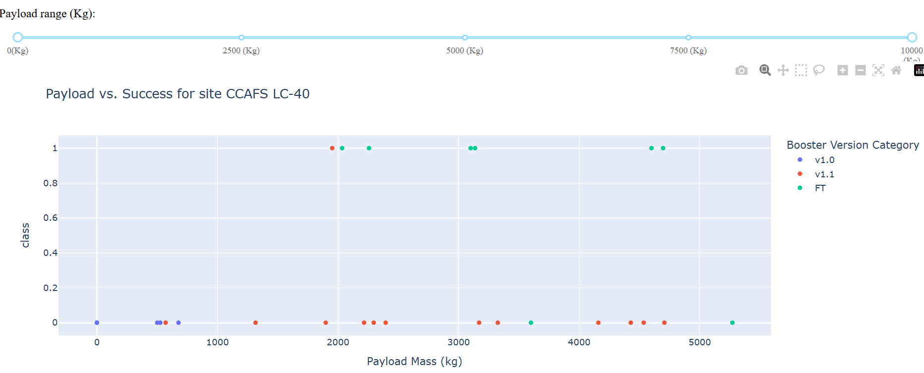
Payload Vs Success site CCAFS LC-40
For this site, the FT booster version had the most success. Version v1.0 failed in all attempts here and never had a payload larger than 1000KG while v1.1 had one success around 2000KG it failed most of its attempts at a wide variation of payloads

Slide 42
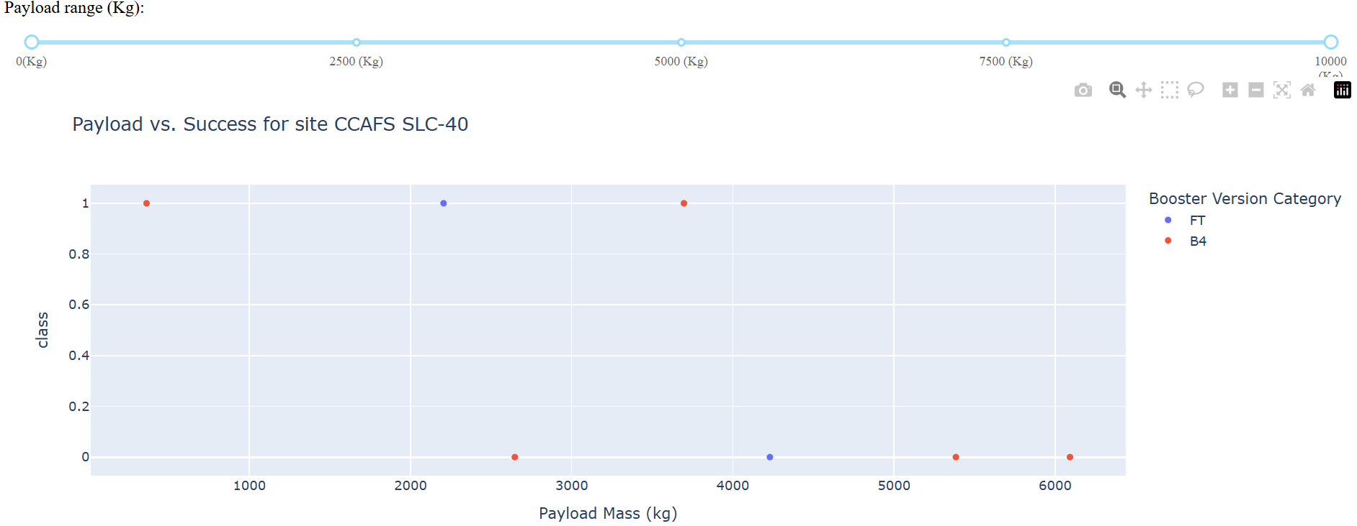
Payload Vs Success site CCAFS SLC-40
For this site, there were only 3 of 7 successful attempts. The booster version FT only had 2 attempts, 1 success and 1 failure and ranged between a payload of 2000KG and 4500KG. Booster version B4 had 5 attempts 3 failures and 2 successes across many different payloads from under 1000KG and a little over 6000KG

Slide 43
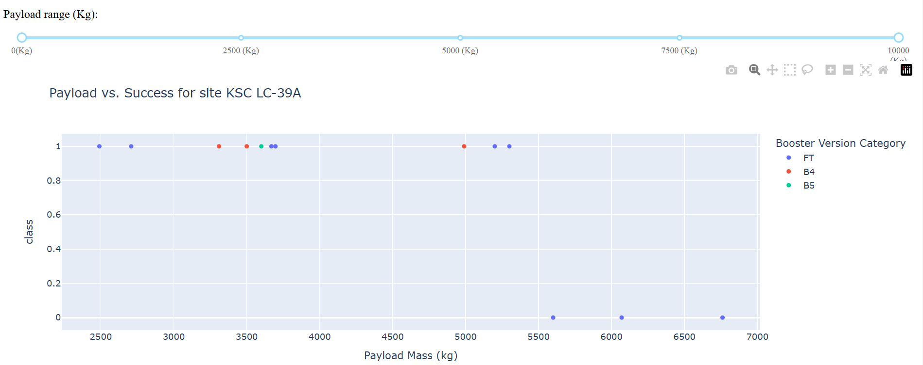
Payload Vs Success site KSC LC-39A
For this site, there were 10 successes and 3 fails. Booster version FT had the most attempts with 9 total, with 6 successes and 3 fails, across payloads from just below 2500KG to around 6800KG. Version B4 had 3 attempts all successes and version B5 had 1 successful attempt.

Slide 44
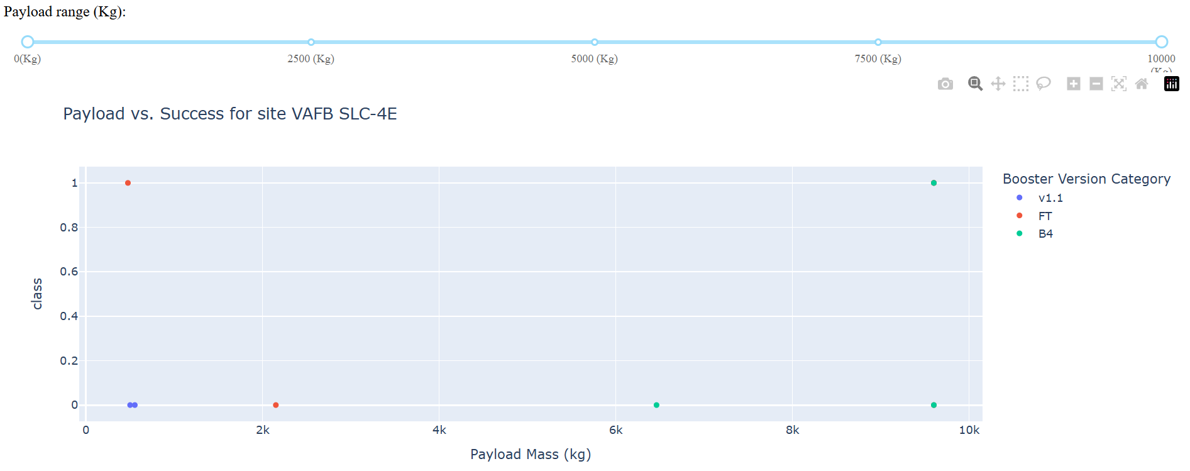
Payload Vs Success site VAFB SLC-4E
For this site, there was only two successful attempts with widely variating payloads. Both of version’s v1.1 attempts were failures. Version FT had success at the lower payload around 500KG but failed around 2100KG. Version B4 failed twice and succeeded once with heavier payloads than the other two versions.

Slide 45

Section 5

Slide 46
Classification Accuracy
Accuracy on the test data was the same for all different models at around 83.333%. This is mainly due to the small test sample size of only around 18 observations.

Slide 47
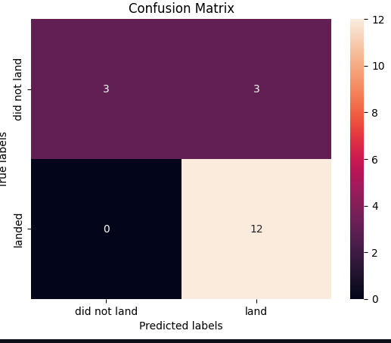
Confusion Matrix
Confusion matrix was the same for all models as well as the accuracy on the test data for each model. Since the test data size was so small. It gave 3 false positives where it predicted landed when in truth it was not landed.

Slide 48
Conclusions
If SpaceY is a new high-risk it could need some time to see positive results as is shown by the positive correlation with flight number and success rate as well as the success rate increase in the yearly trend.
If new launch sites are to be used, they should be on the coast of an ocean and close to the equator.
Payload is important and it seems like the smaller the payload is better to land successfully and thus reuse the first stage.
Also having the launch site be close to a railway and highway allows for easy transportation of materials which limits costs. Launch sites also tend to be away from cities which makes sense to limit any potential risk from a failed landing.
Decision trees gave the best training accuracy. However, I would suggest a larger testing data size before a solid opinion can be made since the testing accuracy was the same across all models and the confusion matrix showed the error came from false positives which can lead to some potentially fatal or high-risk situations.

Slide 49
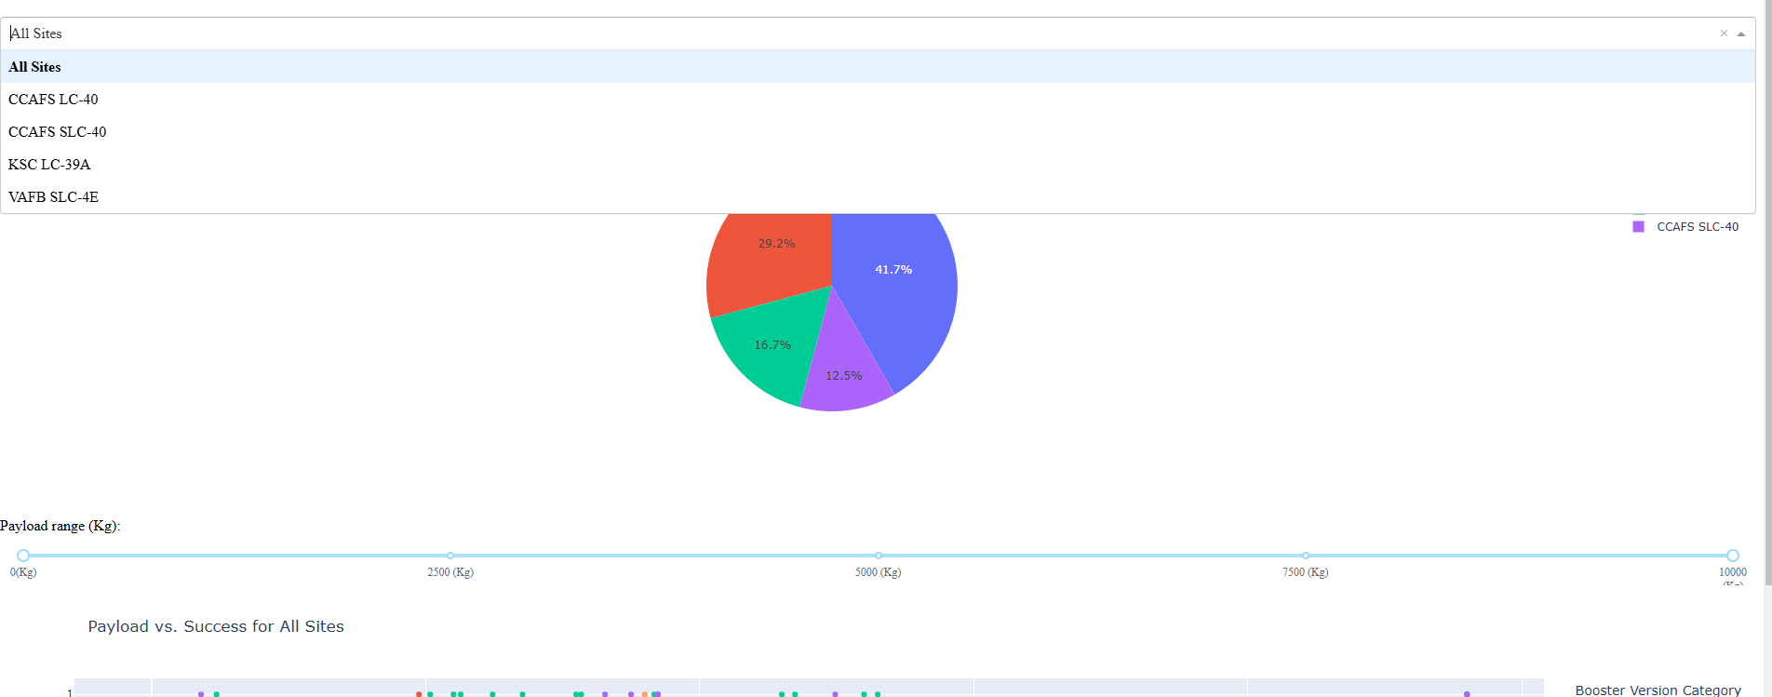
Appendix
Shows dropdown menu options, and the full slider displayed. Also, a peak of the scatterplot to show that it is plotting for all sites as the dropdown menu selects

Slide 50
Appendix
https://en.wikipedia.org/wiki/List_of_Falcon_9_and_Falcon_Heavy_launches
Wikipedia Link used for Webscraping data collection
https://github.com/cjdrummond/Falcon9-Capstone
Link to GitHub Repository

Slide 51


